Slide 1

QF621 Quantitative Trading Strategies
Brandon Lee Dani Surya Pangestu
Gabriel Woon Chan Pak Lam
Peter Chettiar Wong Yong Wen

Slide 2
Pairs Trading Strategy Using Machine Learning
Problem Statement
Research Methodology
Pairs Selection
Contents
Trading Models
OLS
R-OLS
Kalman Filter with Bollinger Bands
Support Vector Machine with Markov Regime Switching

Slide 3

Problem Statement

Slide 4
Problem Statement
Implement machine learning in the entire process of the pairs trading framework
Pairs Selection
Does it outperform the rational/fundamental selection process?
Trading Model
Does the more complex algorithms produce better results?

Slide 5

Research Methodology

Slide 6
Research Methodology (Futures Products)
Metals
Steel
Non-Ferrous Metal
Chemical
Ethanol
Fertilizer
Energy
Agriculture
Crude Oil
Gas
Precious Metal
Fuel Oil
Heating Oil
Diesel
Electricity
Jet Fuel
Sulphur
Naphtha
Propane
Soy
Corn
Wheat
Rice
Milk
Steers
Hog
Wool
Palm Oil
Sugar
Cocoa
Cotton
Number of Commodities: 66
Number of Pairs: 2,145

Slide 7
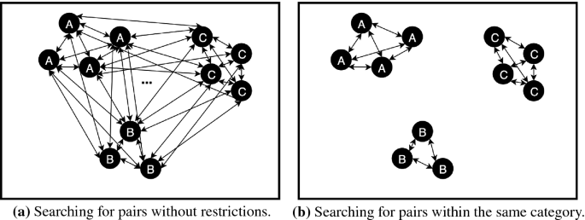
Pairs Selection (Clustering)

Slide 8
Rationale
The simplest procedure commonly applied is to generate all possible candidate pairs by considering the combination from every security to every other security in the dataset.
Two different problems arise immediately:
First, the computational cost of testing mean-reversion for all the possible combinations increases drastically as more securities are considered.
The second emerging problem is frequent when performing multiple hypothesis tests at once and is referred to as the multiple comparisons problem. If 100 hypothesis tests are performed (with a confidence level of 5%) the results should contain a false positive rate of 5%.

Slide 9
Clustering Methodology
Pairs Selection Period
01/01/2009
31/12/2017
Unsupervised learning clustering techniques can solve the task at hand:
K-Means
Hierarchal
Affinity Propagation

Slide 10
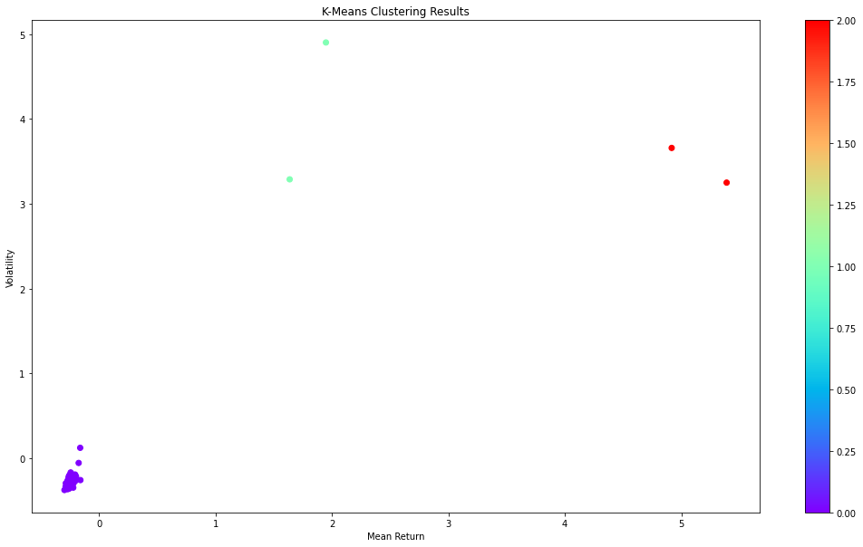
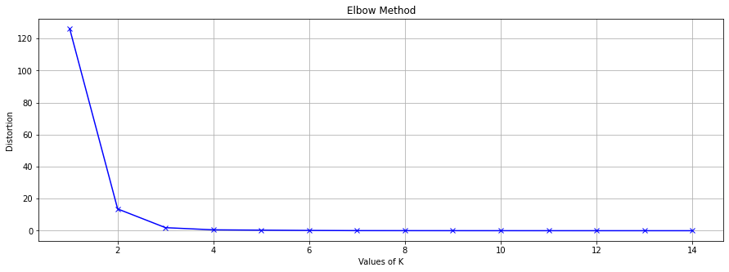
K-Means Clustering

Slide 11
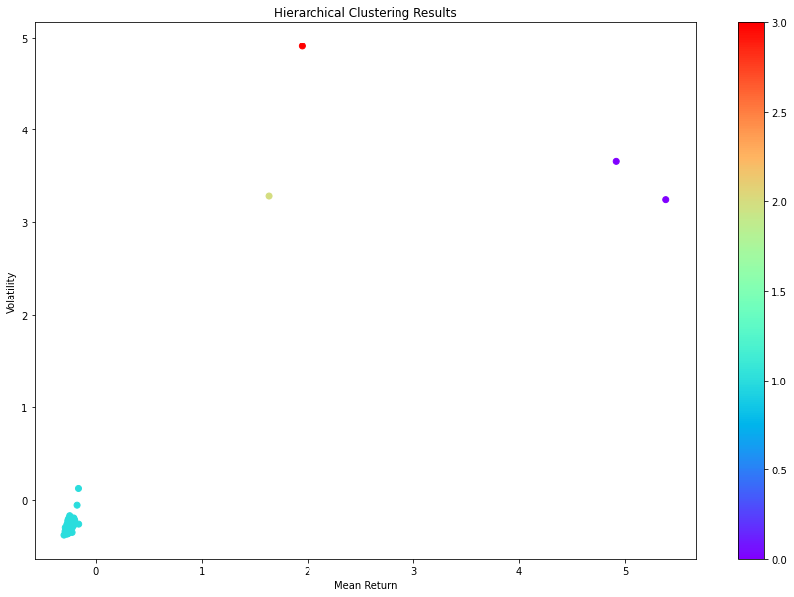
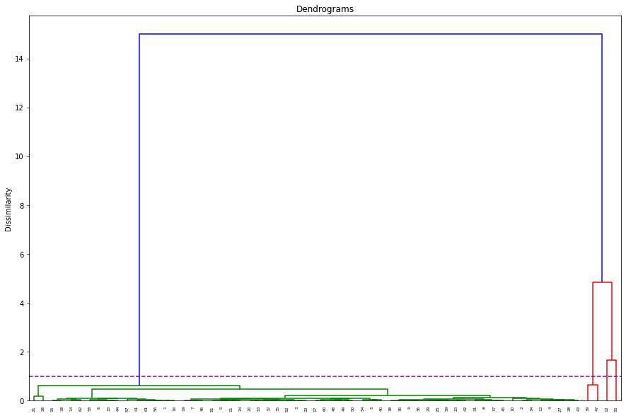
Hierarchical Clustering

Slide 12
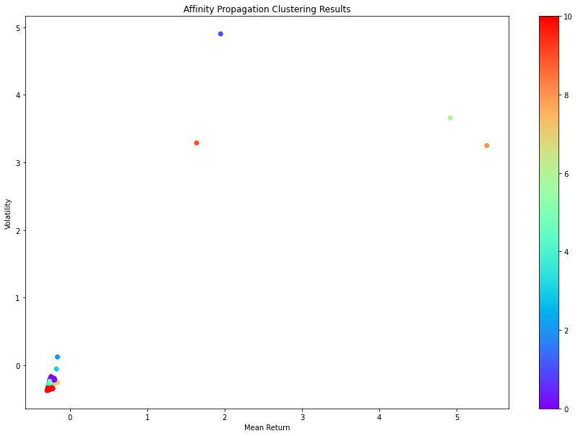
Affinity Propagation Clustering

Slide 13
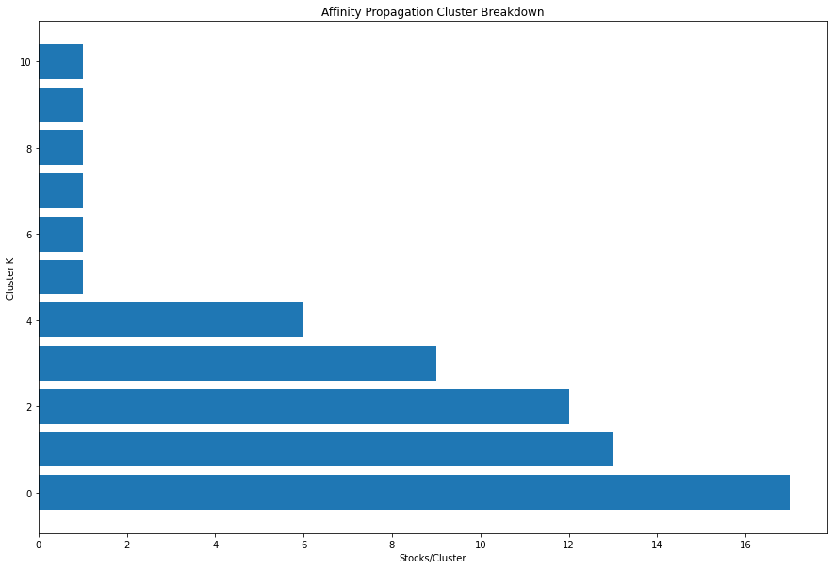
Clustering Evaluation
Silhouette Score:
K-Means Clustering 0.29743
Hierarchical Clustering 0.30728
Affinity Propagation Clustering 0.94311
Number of Clusters: 5
Number of Pairs: 662

Slide 14
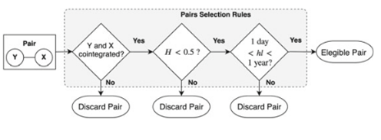
Absolute Rules of Disqualification (ARODs)
Step 1 - the selection process starts with the testing of pairs, generated from the clustering step, for cointegration using the Engle-Granger test. This cointegration testing method was chosen based on its simplicity.

Slide 15
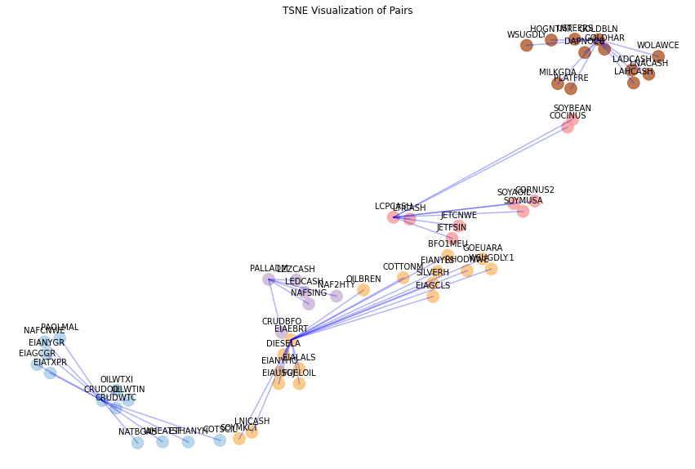
Absolute Rules of Disqualification (ARODs)
Number of Pairs: 52

Slide 16
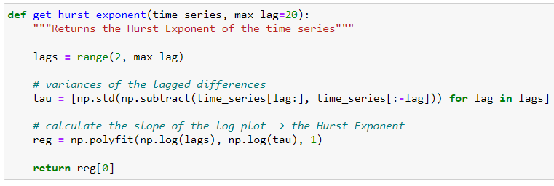
Absolute Rules of Disqualification (ARODs)
Step 2 - a validation step is implemented to provide more confidence in the mean-reversion character of the pairs’ spread. The condition imposed is that the Hurst exponent associated with the spread of a given pair is enforced to be smaller than 0.5, assuring the process leans towards mean-reversion. The Hurst exponent is a measure that quantifies the amount of memory in a specific time series, which in this case means, how mean-reverting is the process under analysis.

Slide 17
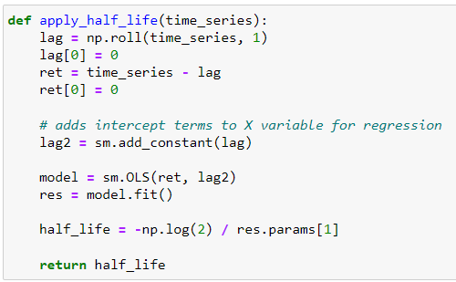
Absolute Rules of Disqualification (ARODs)
Step 3 - the pair’s spread movement is constrained using the half-life of the mean-reverting process. The half-life is the time that the spread will take to mean-revert half of its distance after having diverged from the mean of the spread, given a historical window of data. For medium-term price movements, the spreads that have very short (< 7 day) or very long mean-reversion (> 365 days) periods are not suitable.

Slide 18
Absolute Rules of Disqualification (ARODs)
Template Example
 | Leg1 | Leg2 | Hedge Ratio | Hurst Exponent | Half Life
0 | EIAEBRT | OILBREN | 0.99142 | 0.10075692 | 2.774739157
1 | EIAEBRT | EIAUSGJ | 0.02592675 | 0.25199634 | 19.14888229
2 | EIAEBRT | BFO1MEU | 0.94940347 | 0.27979398 | 8.413260033
Number of Pairs: 27

Slide 19
Final Pairs
Universe
2145
Clustering
662
Cointegration
52
Hurst & Half Life
27
CRUDOIL-EIANYGR
CRUDOIL-EIAGCGR
CRUDOIL-OILWTXI
GOLDBLN-GOLDHAR
LCPCASH-JETCNWE
LCPCASH-LTICASH
PALLADM-LZZCASH
LNICASH-RHODNWE
LCPCASH-GOEUARA
WHEATSF-NAFCNWE
WHEATSF-EIANYGR
WHEATSF-EIAGCGR
WHEATSF-NATBGAS
EIAEBRT-OILBREN
EIAEBRT-EIAUSGJ
EIAEBRT-BFO1MEU
EIAEBRT-GOEUARA
EIAEBRT-EIALALS
EIAEBRT-EIANYHO
EIAEBRT-EIANYLS
EIAEBRT-EIAGCLS
EIAEBRT-DIESELA
EIAEBRT-FUELOIL
CRUDOIL-OILWTIN
CRUDOIL-NAFCNWE
CRUDOIL-CRUDWTC
CRUDOIL-ETHANYH

Slide 20

Trading Models

Slide 21
Trading Model 1 Ordinary Least Squares (OLS)
Trading parameters:
Training period from 2017-01-01 to 2017-12-31 (1 year)
Test period from 2018 onwards till Apr 2022 (~4.33 years)
Static Hedging (using the same hedge ratio throughout the testing period)
Long/Short the spread if the spread is smaller/greater than the average spread volatility derived in training period
If the spread is greater/smaller than 2.5x spread vol, we will liquidate our position (part of our risk management measure)

Slide 22
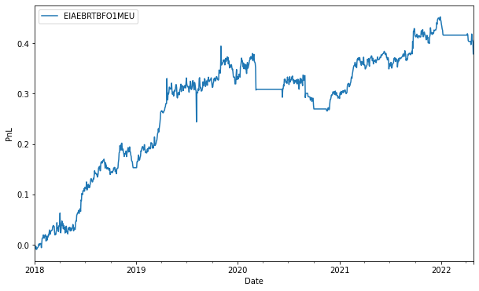
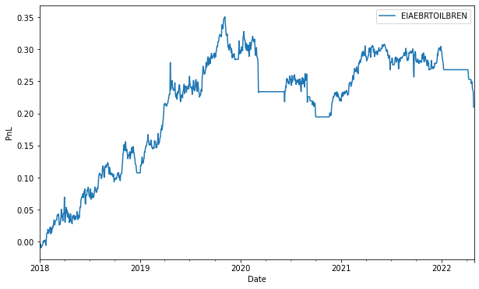
Trading Model 1 Ordinary Least Squares Result
Out of 27 pairs identified, only 2 pairs gave positive PnL result.
Pair Name | Cum. Return | Sharpe ratio | Sortino ratio | Max drawdown
EIAEBRT-OILBREN | 0.209887 | 0.46816 | 0.04090 | -0.14966
EIAEBRT-BFO1MEU | 0.378797 | 0.75566 | 0.06808 | -0.12654
Name | Type | Sub-Type | Ticker
Europe Brent Spot FOB U$/BBL Daily | Energy | Crude Oil | EIAEBRT
Crude Oil BFO M1 Europe FOB $/BBl | Energy | Crude Oil | OILBREN
Crude Oil BFO M1 Europe FOB $/Bbl | Energy | Crude Oil | BFO1MEU
Fundamentally, both pairs are in the same industry (Energy- Crude Oil)

Slide 23
Trading Model 2 Rolling OLS (R-OLS)
Trading parameters:
OLS regression run based on rolling 252 trading days
Dynamic hedge ratio
Long/Short the spread if the spread is smaller/greater than the rolling spread volatility (based on past 252 days)
If the spread is greater/smaller than 2.5x spread vol, we will liquidate our position (part of our risk management measure)

Slide 24
Compare OLS vs Rolling OLS (R-OLS)
OLS :Out of 27 pairs identified, only 2 pairs produced positive PnL
Rolling OLS: Out of 27 pairs identified, 20 pairs produced positive PnL
Pair Name | Cum. Return | Sharpe ratio | Sortino ratio | Max drawdown
EIAEBRT-OILBREN (OLS) | 0.209 | 0.468 | 0.041 | -0.149
EIAEBRT-OILBREN (R-OLS) | 0.548 | 0.716 | 0.0560 | -0.313
EIAEBRT-BFO1MEU OLS | 0.378797 | 0.75566 | 0.06808 | -0.12654
EIAEBRT-BFO1MEU (R-OLS) | 0.537 | 0.674 | 0.0532 | -0.333
Name | Type | Sub-Type | Ticker
Europe Brent Spot FOB U$/BBL Daily | Energy | Crude Oil | EIAEBRT
Crude Oil BFO M1 Europe FOB $/BBl | Energy | Crude Oil | OILBREN
Crude Oil BFO M1 Europe FOB $/Bbl | Energy | Crude Oil | BFO1MEU
Fundamentally, both pairs are in the same industry (Energy- Crude Oil)

Slide 25
Trading Model 3 Kalman Filter with Bollinger Bands
Why Kalman Filters are important?
It removes arbitrariness of other methods.
Trading Parameters:
Trading Period of 1st January of 2018 to 29th April 2022
Equal allocation of capital for each pairs
Daily stop loss of 5%
We will use Bollinger Band to make decision to enter or exit the trade.
Using the data of 125 days before the trade
Short the spread when it exceeds the mean +1.5 Standard Deviation

Slide 26
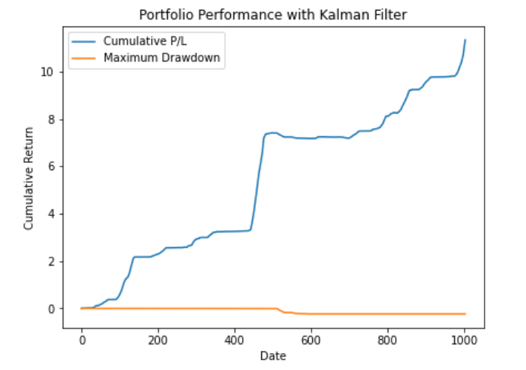
Trading Model 3 Kalman Filter with Bollinger Bands
Profitable Pairs
EIAEBRT-OILBREN
EIAEBRT-EIAUSGJ
EIAEBRT-BFO1MEU
EIAEBRT-EIALALS
EIAEBRT-EIANYHO
EIAEBRT-EIANYLS
EIAEBRT-EIAGCLS
EIAEBRT-DIESELA
EIAEBRT-FUELOIL
CRUDOIL-NAFCNWE
CRUDOIL-ETHANYH
CRUDOIL-EIANYGR
CRUDOIL-EIAGCGR
CRUDOIL-OILWTXI
LCPCASH-JETCNWE
LCPCASH-GOEUARA
WHEATSF-NAFCNWE
WHEATSF-EIANYGR
WHEATSF-EIAGCGR
19 pairs provide a positive PnL using Kalman Filter.
Cum.Return | 958.8%
Sharpe Ratio | 0.445
Sortino Ratio | 7.51
Max. Drawdown | 2.78%

Slide 27
Trading Model 4 Support Vector Machine with Markov Regime Switching
Final Pairs
EIAEBRT-OILBREN
EIAEBRT-BFO1MEU
EIAEBRT-GOEUARA
EIAEBRT-EIALALS
EIAEBRT-DIESELA
CRUDOIL-NAFCNWE
LCPCASH-JETCNWE
LCPCASH-LTICASH
PALLADM-LZZCASH
LNICASH-RHODNWE
LCPCASH-GOEUARA
WHEATSF-NAFCNWE
WHEATSF-EIANYGR
WHEATSF-EIAGCGR
WHEATSF-NATBGAS
Identify change in regime using Markov switching regime model
Generate dynamic hedge ratio using Support Vector Regression, 2-step Engle-Granger method
Notes:
Regime switching vs structural breaks -> why 15 pairs ; convergence -> EGM ; replace OLS with SVR, why better
1. From the pair selection process, we used the cointegrated 27 pairs in the Markov regression model to find the periods of regime changes (i.e. from high mean regime to low mean and vice-versa, switching variance = TRUE). Unfortunately, not all the pairs attained SVD convergence and hence were left with only 15 pairs.
Regime changes can be described as a temporary break between the historic relationship between two assets (i.e. changes in mean and variance), and their spread can deviate significantly from its historical equilibrium leading to a new equilibrium state. There may be a myriad of reasons as to why a temporary regime change occurs, but common reasons include financial crisis, period of economic recession or market crash (e.g., stock market crash of 2020 which happened because of pandemic).
2. Then based on the periods identified, we ran SVR to generate dynamic hedge ratios between the regime changes for each pair

Slide 28
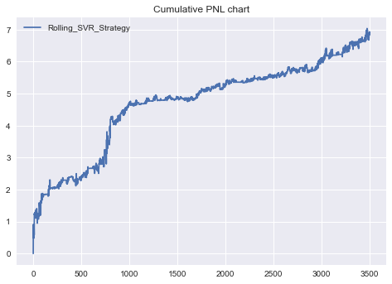
Trading Model 4 Support Vector Machine with Markov Regime Switching
Trade Position | Trade Position (numerical) | PnL
BUY | 1 | (100∗price_S2) − (100∗hedge_ratio∗price_S1)
SELL | -1 | (100∗hedge_ratio∗price_S1)−(100∗price_S2)
Hold | 0 | NA = 0
Performance Metrics
Cumulative Return | 685%
Sharpe Ratio | 0.5833
Max Drawdown | -51.91%
Notes:
3. Then we generate spread series for each of the 15 pairs based on the dynamic hedge ratios and then generate signals based on our 30 day rolling mean + std threshold (if above --> short and below --> long)

Slide 29
Conclusion
Component | Complexity | Machine Learning Method | Success Factor | Proof of Concepts
Pairs Selection | Medium | Clustering | Reduced unique pairs from 2145 to 27 | ✓
Trading Model 1 | Low | Ordinary Least Square | 2 positive PnL with very low cumulative return | χ
Trading Model 2 | Low | Rolling Ordinary Least Square | 20 positive PnL with very low cumulative return | χ
Trading Model 3 | High | Kalman Filter with Bollinger Band | 19 positive PnL with high cumulative return | ✓
Trading Model 4 | High | Support Vector Machine with Markov Regime Switching | 11 positive PnL with high cumulative return | ✓

Slide 30
Conclusion
Pairs Selection
Does it outperform the rational/fundamental selection process?
ANS: Yes
Trading Model
Does the more complex algorithms produce better results?
ANS: Yes

Slide 31

FAQ

